Slide 1
Review of “Subjective well-being related to satisfaction with daily travel”
Authors
Cecilia Jakobsson Bergstad
Amelie Gamble
Tommy Garling
Olle Hagman
Merritt Polk
Dick Ettema
Margareta Friman
Lars E. Olsson
Publication Date
27 May 2010
Lab: Traffic and City
Student ID: D22WA003
Name: Tomoichi Ebata

Slide 2
0. Terminology, definitions
Others

Slide 3




0-1. Terminology
Term | Outline | Others
Health | “Health is a state of complete physical, mental and social well-being and not merely the absence of disease or infirmity. | Definition by WHO
Well-being | A state of happiness and fulfillment in all aspects of life: physical, mental, and social | Using this icon →
Satisfaction | Fulfilment of one's wishes, expectations, or needs, or the pleasure derived from this. | Using this icon →
ー Positive emotions
ー Motivation and immersion
ー Awareness of self
ー Mindfulness
ー Psychological resistance/resilience
ー Empathy
ー Compassion and altruistic behavior
Similar
Well-being
Satisfaction

Slide 4
0-2. Definitions
Term |  | Contents | Ebata’s opinion
Subjective Well-Being : SWB) |  | ■No definition of "happiness" at all ■Answer "How happy do you feel about yourself" → Clarification ■Hence, the "survey" is the main focus. | No concept of "happiness that can be compared to others"
Two SWBs | (A)Cognitive SWB | ■Based on an individual's (self-imposed) assessment of well-being ■Also known as "life satisfaction“ ■Self-evaluations of other specific domains of life in general, such as work, consumption, health, relationships with family and friends, and leisure time (domain-specific SWB). | Personal "happiness" based on the "rules of your own happiness"
 | (B)Affective SWB | ■Positive emotions of joy, fulfillment, enjoyment ■Negative emotions such as sadness, anger, disappointment ■Response portion of the individual as determined from the above multidimensional | Happiness" based on feelings that arise spontaneously inside you, non-logically, without even rules within you.

Slide 5


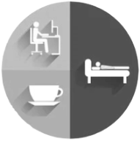
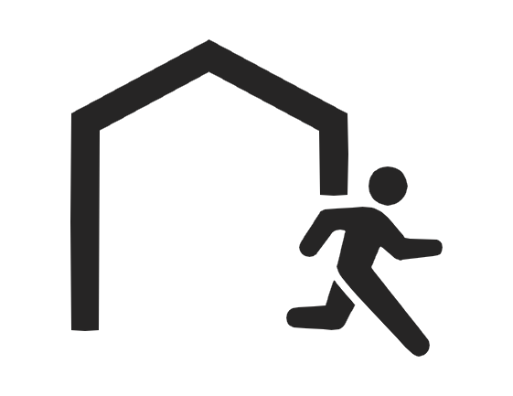

0-3. Icons using this presentation
Term | Icon
Satisfaction with performance
Satisfaction with daily travel
Satisfaction with daily Life
Out-of-home Activities
Term | Icon
Cognitive SWB
Affective SWB
Joy, fulfillment, enjoyment
Sadness, anger, disappointment

Slide 6
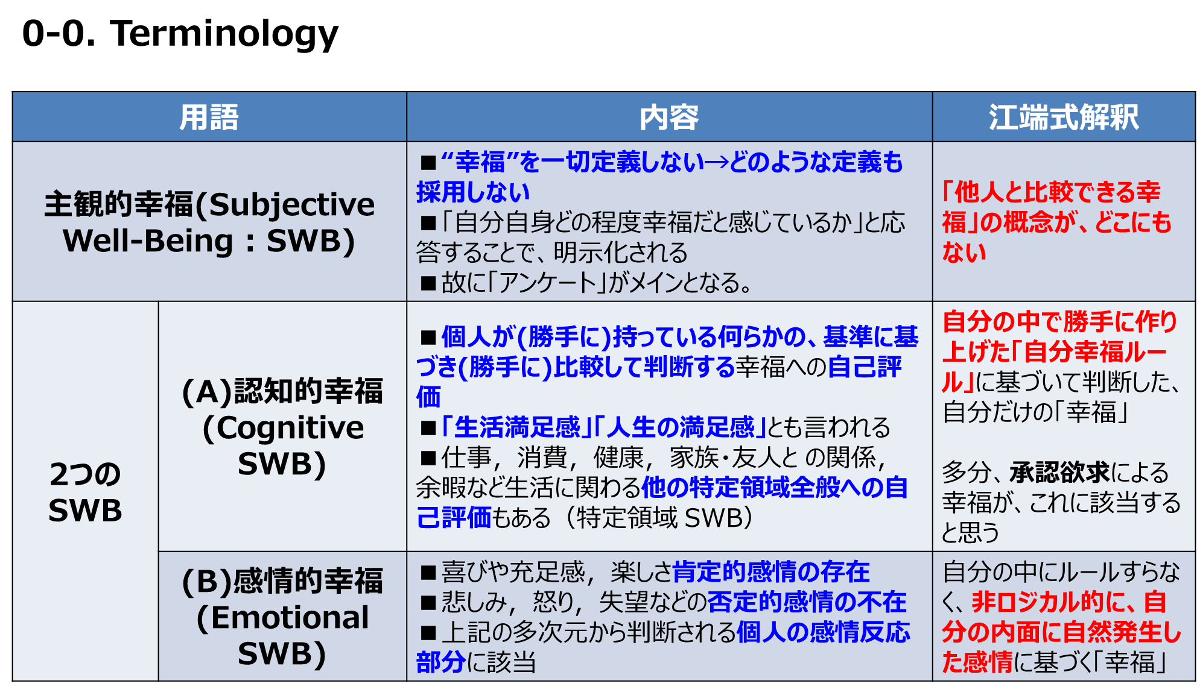
(for Ebata’s only)

Slide 7
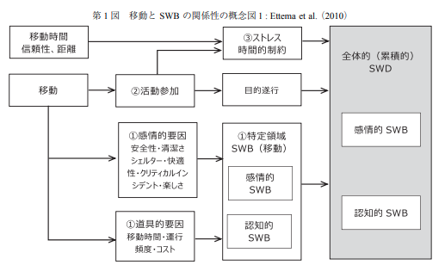
Ebata’s memorandum

Slide 8
1. Overviews

Slide 9


1-1. Overview(1)
Background (1)Many previous studies show
affect
Subject
Well-Being (SWB)
Out-of-home
Activities
Increase?
2. Purpose of this study (1) “Daily travel” increases SWB? (2) Which car usage maximizes SWB?
Emotional
Which is
Bigger?
Instrumental
A Power Word “SWB(Subject Well-Being)” in this paper

Slide 10
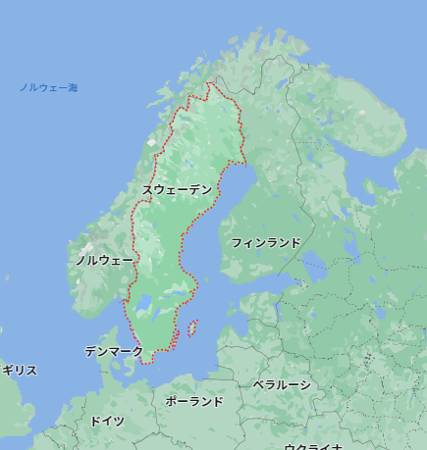

1-2. Overview(2)
Objects (Targets) 1330 persons in Sweden
(1)Car access and use
(2)Satisfaction with daily travel
(3)Satisfaction with performance of out-of-home routine activities
(4)Affective and cognitive SWB

Slide 11
1-3. Overview(3)
Results
Satisfaction with daily travel
Direct Affections
Affective and cognitive SWB
Indirect Affections
Satisfaction with performance
Small effect
×
Weekly use
SWB
Daily Satisfaction
big effect
Performance Satisfaction

Slide 12
2. Literature review

Slide 13
2-1. Literature review(1)
From Utility-Maximization to SWB
Paper | Outline | Others
McFadden 2001 | Utility-maximization theory is the dominant account of how travel-related choices of activity | Doubtful whether utility derived in this way is a valid measure of travellers' satisfaction
Kahneman 1999 | Subjective well-being (SWB) has been proposed as a measure of individuals' benefits in a number of domains | SWB started from the paper.
Diener and Suh 1997 | SWB expresses individuals' cognitive and affective well-being, directly measured by means of reliable psychometric scales
Diener and Seligman 2004; Diener et al.2009 | SWB refers to overall life satisfaction, which is relatively stable over time | Growing interest in understanding how SWB is affected
Ettema （2010） | Study of changes in SWBs from changes in modes of travel and public transportation service levels. | SWBs may find a relationship with the travel context.

Slide 14
2-2. Literature review(2)
Extract Cognitive SWB from SWB
Paper | Outline | Others
Diener (1985) | SWB is assumed to consist of (1)positive affect (PA) and (2)negative affect (NA) from direct experience, and the (3)cognitive component of satisfaction with life as a whole
Stone (1999) | Emotional components (PA and NA) may be assessed by immediate self-report of specific emotions and moods
Kahneman(2004)Schwartz(2009) | Assessments from memory of emotions associated with recent activity were highly correlated with the results of the immediate method | Measure past emotional SWB (e.g., how you felt last week, how you feel overall) or current mood (how you feel now)
Diener(1985) Pavot & Diener (1993） | Cognitive SWB is assessed by a 5-item life satisfaction scale.

Slide 15
2-3. Literature review(3)
Miscellaneous info. about SWB
Miscellaneous
(1)Both affective and cognitive SWB are stable and probably genetically influenced
(2)Performance on goal-related activities, positive living environment, and higher income have higher SWB
(3)SWB does not increase in proportion to income growth over time
(4)SWB usually has a U-shaped relationship with age, being lowest around age 40 and gradually increasing thereafter.
(5)Marriage tends to increase SWB, while divorce and death of a spouse decrease SWB
(6)Unemployment has been shown to decrease SWB, especially when there is little social support
(7)Results regarding gender are mixed. In some studies, women have higher SWB than men, in others there is no difference, and in still others gender differences vary by life course
(8)It can also be defined in the context of specific domains such as work life, family life, leisure time, etc.
(9)Customer satisfaction is less general than the domain-specific SWB and applies only to those who use the service.

Slide 16

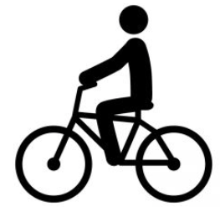





2-4. Literature review(4)
Travellers' satisfaction is influenced by events
affect
Friman and Ga¨rling (2001) and Friman et al. (1998, 2001)
Events during
travel
Loop
affect
Critical incidents
Friman（2004）
Mokhtarian and Salomon 2001; Mokhtarian et al.
Jakobsson Bergstad
（2010）Steg（2005）
Cleanliness, Privacy,
Safety, Convenience,
Stress,
Social interaction,
Scenery
affect
affect
congestion, air quality,
presence of trees and flowers,
presence of beggars,
type of pavement
Bus
environments
Walker

Slide 17
2-5. Summary of Literature reviews
Daily travel itself lead to cumulative satisfaction
Relate
（Schimmack 2008）
Satisfaction with daily travel
SWB
Relate
（Ha¨gerstrand 1970）
Activities in travel
Activities in Dairy life
Relate
Different Means of transportation
Relate
Different
SWB
Relate

Slide 18
3. Method

Slide 19
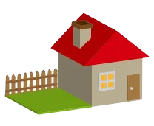







3-1. Sample, Procedure and Questionnaire
Over 20 millions (urban areas)
Over 2 millions (semi-rural area)
Less 2 millions (farming area)
1000
1000
1000
196
Questionnaire
536
543
Sum:1,330
(1) Questions about instrumental, affective, and symbolic motives for car use
(2) Questions about daily travel
(3) Questions about the frequency of performing out-of-home activities and choice of travel mode for performing these activities
(4) Questions about affect associated with performing the activities;
(5) Measures of affective SWB;
(6) Measures of cognitive SWB,
(7) Questions about socio-demographic variables including sex, age, education, income, employment, household type, housing conditions, and car access and use.

Slide 20
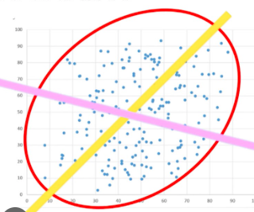
3-2. Satisfaction with daily travel
Developed the Travel Satisfaction Scale (STS) to measure satisfaction with daily travel
(1)Draw the axis at the widest point → maximum dispersion
■ STS: Factor Analysis and Principal Component Analysis with varimax rotation
(2) Draw orthogonal lines
Extracting five parameters
Shrink parameters
# | Parameter(Axis)
1 | “I am completely satisfied with my daily travel"
2 | "Travel facilitates my daily life"
3 | "When I think about my daily travel, the positives outweigh the negatives"
4 | "I would not change anything about my daily travel"
5 | "Daily travel makes me feel good"
Respondents used a 7-point Likert scale ranging from 0 (disagree) to 6 (completely agree).
the STS was created by averaging the ratings for each item

Slide 21
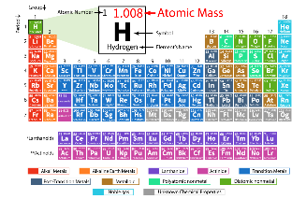

3-3. Satisfaction with activities
Emotions felt by respondents during each activity were measured.
■ Evaluation
atomic value
0 1 2 3 4 5 6 7
Sad,
Dissatisfied
Depressed
Happy
Satisfied
Joyful
Valence
(unpleasant/pleasant)
r = 0.77 for all activities, ranging from 0.69 to 0.91 when each activity was evaluated individually
0 1 2 3 4 5 6 7
Sleepy Reluctant Bored Awake Active
Alert
Activation
(quiet/excited)

Slide 22

3-4. Affective SWB and weekly mood
“What they felt last week” and “what they felt overall”
Valence
(unpleasant/pleasant)
r = 0.80
r = 0.75
Affective SWB
weekly mood
Activation
(quiet/excited)

Slide 23
3-5. Cognitive SWB
Cognitive SWB was assessed by the Satisfaction with Life Scale (SWLS)
Extracting five parameters
(*)A measure of internal consistency, that is, how closely related a set of items are as a group.
# | Parameter(SWLS)
1 | My life is close to my ideals
2 | Conditions of my life are excellent
3 | I am satisfied with my life
4 | So far I have achieved the important things I want in life
5 | if I could live my life again I would change almost nothing
Inter-item correlations ranged from 0.54 to 0.79
A Cronbach's alpha^{(*)} of 0.90
Cognitive SWB

Slide 24
4. Data analyses

Slide 25




4-1. Data analyses
Three viewpoints from “regression analysis”
One
Emotional
Instrumental
Satisfaction with daily travel
STS
Weekly
mood
Two
Three
Affective SWB
Satisfaction with Performance
SAS

Slide 26
5. Results

Slide 27



5-1. Data trend(1)
d^{s} indicates that the distribution deviates significantly from the normal distribution
# | Item | Size | mean | SD | d^{s} | 1 | 2 | 3 | 4 | 5 | 6
1 | Cognitive SWB | 1320 | 4.0 | 1.3 | 0.09
2 | Affective SWB | 1313 | 1.3 | 1.2 | 0.16 | 0.64
3 | Weekly mood | 1320 | 1.0 | 1.3 | 0.13 | 0.56 | 0.68
4 | SAS | 1298 | 1.3 | 0.9 | 0.06 | 0.37 | 0.48 | 0.55
5 | STS | 1317 | 3.7 | 1.3 | 0.06 | 0.24 | 0.20 | 0.22 | 0.26
6 | Car in household | 1313 | 1.5 | 0.8 | 0.24 | 0.15 | 0.08 | 0.08 | 0.02 | 0.01
7 | Weekly car use (%) | 1290 | 76.8 | 33.4 | 0.32 | 0.06 | -0.02 | 0.03 | -0.06 | 0.08 | 0.47
■Trip satisfaction [STS] and cognitive SWB range from 0 to 6, with higher values indicating higher STS and cognitive SWB.
■Activity Satisfaction [SAS], Cognitive SWB, and Global Affective SWB range from -3 to 3, with higher values indicating higher STS and cognitive SWB.
■Positive affect ranges from -3 to 3, with negative values indicating negative affect
and positive values indicating positive affect.

Slide 28
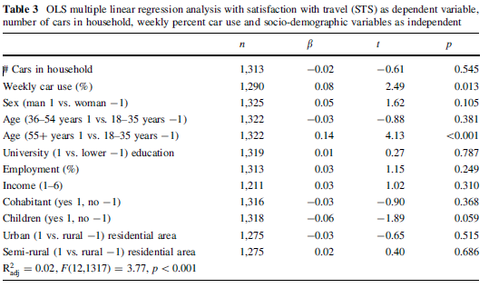
5-2. Data trend(2)
OLS multiple regression analysis with travel satisfaction (STS) as the dependent variable

Slide 29

5-3. Data trend(3)
# | Summaries | Pictures with Icons
1 | Regression coefficients for STS are slightly different for weekly mood, affective SWB, and cognitive SWB,
 | However, all three analyses show significant regression coefficients with positive signs
2 | Regression coefficients for sex, cohabitation, education, and employment tend to increase from weekly mood through emotional SWB to cognitive SWB
3 | Regression coefficients for household car ownership and car ownership per week are not significant.
4 | Results for the two age variables yielded a U-shaped relationship with both affective and cognitive SWB
5 | No age differences were obtained for weekly mood
sex, cohabitation, education, and employment tend
×
Age
×

Slide 30

5-4. Conclusion of Data Analyses
A Figure of Simple relationship
Affect
Input
SAS
STS
Cognitive
SWB
Affect
Affect?
Affect
Affective
SWB
Car in household

Slide 31
6. Discussion

Slide 32
6-1. Conclusions
The impact of satisfaction with daily mobility (STS) on emotional and cognitive SWB is both direct and mediated by satisfaction with activity performance (SAS)
Direct
STS
SWB
Indirect
SAS
Car use plays only a minor role in satisfaction with daily mobility and its impact on SWB
SWB
STS
Small effect
×
Weekly use
SWB
Daily Satisfaction

Slide 33
6-2. Reasons of the conclusions
Because the automobile is superior to other modes of transportation, they adjust their schedule of activities so that they have less need for multi-purpose travel, or they have chosen to live in a location with satisfactory public transportation services
Older respondents and those without children are presumed to have less complex mobility needs than younger respondents and those with children,
and therefore are more satisfied with their daily mobility

Slide 34
7. Others

Slide 35
7-1. About SWB、STS
Subjective Well-Being(SWB) scale has been used and established in numerous studies.
Travel Satisfaction Scale (STS) was designed as a general measure of satisfaction with daily travel that can be used for any travel mode or combination of travel modes, and was shown to be a reliable measure.
An improved version of the STS could be a useful tool for comparing different modes of transportation and other aspects of travel services and identifying factors that increase satisfaction with daily travel and, ultimately, subjective well-being

