Slide 1
Review of “Do changes in neighborhood characteristics lead to changes in travel behavior? A structural equations modeling approach”
Authors
Cao, XinYu
Mokhtarian, Patricia L
Handy, Susan L
Publication Date
2007-09-01
Lab: Traffic and City
Student ID: D22WA003
Name: Tomoichi Ebata

Slide 2


1. Overview
Background (1)Suburban sprawl has been widely criticized for its auto dependence (2)Only the "static" relationship between the built environment and the travel environment has been analyzed.
Problems (a)"Does the built environment influence mobility?“ when socio-demographics, attitudes, and thoughts are controlled? (b)” Are there reasons for moving?” Self-selection of residence can explain individual travel behavior?
Conclusion
Suburb’s transportation can reduce car dependence and increase walking "to some extent".
Traffic design in suburb can solve “auto dependence”

Slide 3




2. Frequent Terms
Moving
Urban
Suburban (Suburb)
Build
Environment
Build
Environment
Travel Environment
/ behavior
Travel Environment
/ behavior
Behavior (How to do)
Attitude (How to feel)

Slide 4
3-1. Literature review(1)
Paper | Outline | Others
Cao, 2006a | Variation in travel behavior owes more to conscious factors than land availability | Travel behavior is less influenced by the environment.
Cao, 2006b | Suburban environments more often inhibit urban travel behavior than suburban environments inhibit suburban travel behavior. | Directed influence by the built environment, independent of self-selection
Chatman(2005) | The built environment is not significantly different between those who are modally aware and those who are not. | Housing choice does not significantly explain travel behavior
Only a one-way model from built environment to travel behavior

Slide 5
3-1. Literature review(1)
Paper | Outline | Others
Cao, 2006a | Variation in travel behavior owes more to conscious factors than land availability | Travel behavior is less influenced by the environment.
Cao, 2006b | Suburban environments more often inhibit urban travel behavior than suburban environments inhibit suburban travel behavior. | Directed influence by the built environment, independent of self-selection
Chatman(2005) | The built environment is not significantly different between those who are modally aware and those who are not. | Housing choice does not significantly explain travel behavior
Travel behaviors are derived from several reasons
Difficult for suburban people to go urban
Built environment is not so important for moving
Just a one-way model from built environment to travel behavior

Slide 6
3-2. Literature review(2)
Paper | Outline | Others
Bagley and Mokhtarian(2002) | (1)Housing type has little impact on travel behavior, (2)No direct causal relationship between built environment and travel behavior | Hence the authors said that another variable should be examined
Finkel(1995) | Show causal relationship from built environment to travel behavior | Suggests that noise can be reduced by considering the time factor
Boarnet(2005) | How to change the pedestrian-bicycle relationship through "education” | Survey results are suspected to be subject to memory bias and desirability bias.
Krizek(2003) | Statistical proof that improved transportation access can change travel behavior | The content of traffic access varies depending on the type of traffic
Meurs and Haaijer(2001) | (1) Travel behavior changes depending on residential environment, (2) Automobile travel varies with the rate of automobile ownership. | Those who do not travel are not affected.
Haddy(2005,2006) | Discovered that neighborhood change is directly related to behavior change. | However, (the author) said that is neither definitive nor essential
Relation between built and travel environments

Slide 7
3-2. Literature review(2)
Paper | Outline | Others
Bagley and Mokhtarian(2002) | (1)Housing type has little impact on travel behavior, (2) No direct causal relationship between built environment and travel behavior | Hence the authors said that another variable should be examined
Finkel(1995) | Show causal relationship from built environment to travel behavior | Suggests that noise can be reduced by considering the time factor
Boarnet(2005) | How to change the pedestrian-bicycle relationship through "education” | Survey results are suspected to be subject to memory bias and desirability bias.
Krizek(2003) | Statistical proof that improved transportation access can change travel behavior | The content of traffic access varies depending on the type of traffic
Meurs and Haaijer(2001) | (1) Travel behavior changes depending on residential environment, (2) Automobile travel varies with the rate of automobile ownership. | Those who do not travel are not affected.
Haddy(2005,2006) | Discovered that neighborhood change is directly related to behavior change. | However, (the author) said that is neither definitive nor essential
Housing type has little impact on travel behavior
Relation from “built environment” to ”travel behavior” is clear
Education for children is effectiveness
Transportation access changes travel behavior
Travel behavior changes depending on residential environment
Neighborhood change is related to behavior change
Relations between built and travel environments

Slide 8
4. Methodology

Slide 9


4-1. Data and variables ( Questionnaire subjects)
Urban
Suburban
Moving in one year
4 Regions
4 Regions
524 person in North California
<
(5)House size
(1)Percent females
(2)AutoMobile
(3)child
(4)Age
The (1)～(5) of Suburban are larger than of Urban

Slide 10


4-2. Travel behavior( outer, visible, how to do)
34 features about the region Facilities (bank, church, library, post office), Maintenance (food, pharmacy), Eating out (bread, pizza, fast food, take-out) and Leisure (health clubs, bookstores, bars
Location search Using Yellow Pages and ArcGIS (GIS tool)
Main index (a)Number of business types and (b) Distance to nearest facility
Questionnaire
4-point scale from (1) does not apply at all to (4) does apply at all or 4 levels from (1) not important at all to (4) very important
Finalized items
(1) Accessibility, (2)Physical activity options, (3) Safety, (4) Sociability, (5) Attractiveness and (6) Outdoor spaciousness
Abstracted and extracted results
Ebata: “I wanted to read the original questionnaire”

Slide 11
4-3. Travel Attitude( inner, invisible, how to feel)
32 features about the region (not described)
Main index (a) Bicycling and walking, (b) transfer, (c) travelers, (d) Travel minimizing (e) Car-dependent (f) Safety of Car
Questionnaire
5 levels from (1)strongly disagree (1) to (5)strongly agree
Finalized items
(1) Pro-bike walk, (2)Travel minimizing, (3)Safety of car, (4)Car dependent
Abstracted and extracted results
Behavior (How to do)
Attitude (How to feel)
Extract 4 significant factors

Slide 12
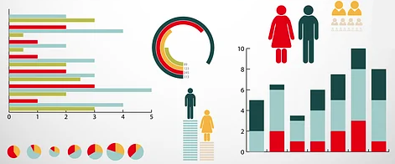



4-4. Social Demographics
Items Gender, Age, Employment Status, Educational Background, Household Income, Household size, Number of children, Mobility constraints, Housing type and size, Number of children in household, Housing tenure
Before and after state comparison (a) Family Composition, (b) Income
Before
After
in one year
Difference between before/after moving in a year

Slide 13
5. Modeling methods SEM and MEL

Slide 14
5-1. What’s SEM(Structural Equation Modeling)(1)
Analysis that models hypotheses in the form of linear combinations with Latent Variables(◯)
Factor
Latent
Variables
Error
factor
(1)Designer determines latent
variables
(2)Only observation variables are known. (Those are data)
(3)The direction of arrow is
(a)from specific factors to
specific data (b)Factor-to-factor is also
acceptable
(c)Correlation is also
acceptable
Observation
Variables
Values of “◯” are calculated by APP automatically

Slide 15
5-2. What’s SEM(Structural Equation Modeling)(2)
Structural equations and data correlations are visible
Simple Example
■The path diagram shows which variables are correlated with each other.
■I (designer) find the coefficients α,β of the structural equation.
→ Value of α, β + Structural equation → Correlation of data
■Conversely, if I (designer) find the values of the structural equations, α, β, I could understand the data deeply
ex
e0
ey
y
f1
z
ez
x
f0
f2
ew
f3
w
Structural Equation
x = α_x0 f0 + βx + ex
y = α_y1 f1 + βy + ey
z = α_z2 f2 + βz + ez
w = α_w3 f3 + βw + ew
f0 = α_01 f1 + α_02 f2 + α_03 f3 + β0 + L0
Use figure and formulas to discover Latent variables

Slide 16
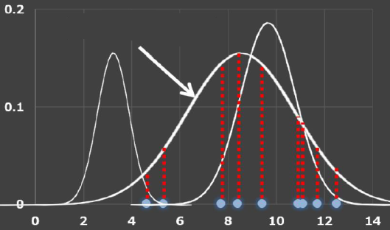
5-3. What’s MLE(Maximum Likelihood Estimation)
Changes observed data with a convenient normal distribution
Good
Standard deviation σ and mean μ can be found by partial differentiation

Slide 17
6. Approach

Slide 18
6-1. Approach of this research
Factor Latent Variables (a) Changes in Travel Behavior (TB), (b) Changes in the built environment (BE),
Direction of the estimated influence (arrows in SEM) (a) From "Change in behavior after the move” to “Change in the built environment“ is true, but the opposite is false. (b) From “Changes in the built environment” to “changes in car
ownership or travel behavior” is true. (c) From “Changes in the built environment” to “changes in
demographics and attitudes“ is true.
Basic structure
AT
ΔBE
AT: Travel Attitude &
neighborhood performer
ΔTB
The above is a basic structure of this research by SEM

Slide 19
6. Results

Slide 20
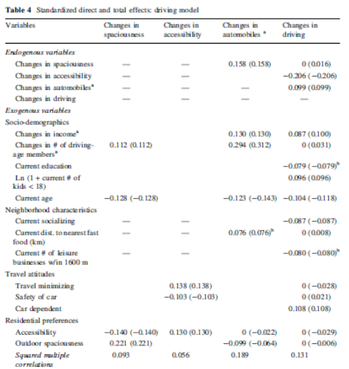
6-1. Final modeling of Driving by SEM
Conceptual structural model
Overview (a) Changes in Spaciousness → Positive correlation with driver age → Negative correlation between “accessibility” and “preference” and “age” (b) Others (more than 7) Summary: Built environment has a direct relationship to car ownership.
Changes in Spaciousness
Changes in Auto Ownership
Demographics and their change
Changes in Accessibility
Changes in Driving Behavior
Current Attitude

Slide 21
6-2. Final modeling of Walking by SEM
Conceptual structural model
Overview (a) Changes in car ownership correlated with income and age (b) Older adults reduce the number of automobiles after moving (C) Outdoor space is negatively correlated with the number of car
Changes in Spaciousness
Changes in Auto Ownership
Demographics and their change
Changes in Accessibility
Changes in Driving Behavior
Current Attitude
Changes in Attractiveness
Changes in Walking Behavior

Slide 22
6-2. Final modeling of Walking by SEM (Con’t)
Attractiveness → Small impact on the elderly → Children apt to avoid moving.
Children → Children don’t want moving
Driving Behavior → Number of children under 18 is the breaking point for driving
behavior.

Slide 23
7. Conclusions

Slide 24
7. Conclusion
Background Suburban sprawl has been widely criticized for its contribution to auto dependence → However, there is no evidence.
Method Using SEM to analyze the relationship between built environment travel behavior → Changes in the built environment, Car ownership, and Travel behavior
Result (a) Self-selection of housing → Influence travel behavior (b) Changes in the Built Environment → Relates to changes in travel behavior (c) Improved accessibility → Biggest factor in reducing driving (d) Attractiveness → Factors increasing walking
Conclusion Reducing cars and increasing walking is possible with proper transportation alternatives even in suburbs

