Slide 1
Introduction to AI Technologies
3rd
Mar 17, 2023
Graduate School of Urban Innovation
Doctoral course for working adults (1st grade)
Tomoichi Ebata
Notes:
Today is the final lecture of this “Introduction of AI Technologies”

Slide 2
2. Today’s Topic
Notes:
Let’s tell you the today’s topic

Slide 3

2. Today’s Topics
GA and Machine Learning
■Probability theory
■Optimization Algorithm
■Statistics
■Image recognition
■Constraint theory
■Voice recognition
■Search
■Natural language processing
AI
(Artificial Intelligent)
■ OR
■Game theory
■Machine learning
(Mar 17th) Today
■Neural Networks
(Mar 10th) Today
■Human interface
■Automatic Translation
■Multi-agent simulation
■Case-based reasoning
■Bayesian network
(Mar 3rd)
■Expert
■Data mining
■Genetic Algorithm (GA)
(Mar 17th) Today
■Fuzzy reasoning
(Mar 3rd)
Notes:
Today’s topic is GA that is short for Genetic Algorithm and Machine learning.
GA was popular in the second AI Boom, and machine learning is now popular in this Boom, especially Shogi, Go and other games.

Slide 4
3. Genetic Algorism
Notes:
Let’s start about Genetic Algorism.

Slide 5


3-1. DNA Mechanisms
Body cells: 60 trillion
Core
Chromosomes: 46
T
G
C
Gene: 20,000 sites
C
A
A
3%
T
G
DNA: 3 billion pairs (base pairs)
Notes:
This figure shows the word around DNA. Ordinal persons cannot say them correctly.

Slide 6
3-2. Attention
“Chromosomes”, “genes”, and “DNA” have different meanings, however…
I think it would be confusing to try to explain exactly them
In this class, I will use just "gene”
(“Chromosomes" is the correct word.)

Slide 7
3.3 What’s Genetic Algorism(GA)”
Ultra-fast solution search method that takes advantage of genetic mechanisms
■ Super-improved version of random search
(e.g., Monte Carlo method)
Amazing how genes work. Easy and fast. It's so easy and fast
That it makes me believe “Maybe God is in the world..”(Just
Ebata’s opinion)
■However, genetic design is "deathly" difficult
If you succeed in designing the gene, you've as good as won.
GA is Ebata's most favorite AI technology
Notes:
GA is (omitted)
GA is a kind of powerful solution search method like Monte Carlo method.
(Omitted)
If you can design the gene, you have already win the problem
In my mind, GA is my favorite AI technology.

Slide 8
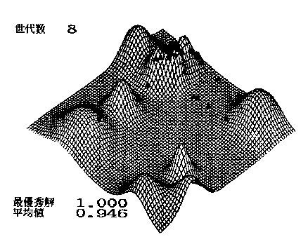
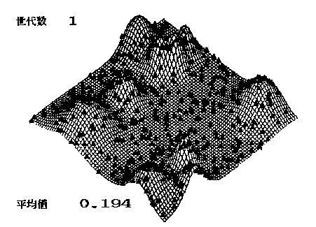
3.4 What’s “Genetic Algorism (GA)”
Scatter a large amount of life in the solution space and let them reproduce on their own -- that's the image
z = f(x,y)
Max(z) → 1.0
Generation : 1
Generation : 8
Average : 0.194
Average : 0.946
Best answer: 1.000
Make a village of 100 people, live for 10 generations, and find the highest mountain
Notes:
What is GA?
The image of GA is that scattering a large amount of life in the solution space and allowing it to reproduce on its own.
It is likely to make a village of 100 people and to live for 10 generation.
In this case, “one” generation means a life time of the person.
Those 100 people marry, have children, and finally die while searching the highest mountains. The next generation repeats the same process.
Only just after the 8th generation, they could find the highest mountain.

Slide 9
3.5 Genetic Algorithm Flowchart(1)
The algorithm is surprisingly simple
Step | Contents | Others
 | Generate many random genes | 100～10000 genes
 | Score the genes | Sort by the order of the good score
 | Cross two genes in pairs | The best genes clone themselves without crossing.
 | Break a part of the genes | Add “mutation” artificially
 | Eliminate poorly formed genes | “Kill” about 10% of the population
Generate a population
Evaluation
Crossover
Mutation
Selection
End
Notes:
GA algorism is very simple.
First, generate a population with gene, Using the random number function
Second, Score the genes and sort by order of the good score. In the previous figure, the score is the height of their house.
Two persons get married and have two children.
The important point is that Children are like their parents, but not the same as their parents. Because there are crossover and mutation, however, I will explain the mechanism after that.
On the other hand, several elite persons who have already get the higher point, don’t get married, but make several their clones, because the more elites are generate, the more the population have a chance to reach the best answer.
After that, several low valued persons are killed, for the population.

Slide 10


3.6 Genetic Algorithm Flowchart(2)
GA is an “Elite Strategies”
Generate a population
1 2 3 4
1 3 2 4
2 1 4 3
1 2 3 4
1 3 2 4
2 1 4 3
Evaluation
Evaluation value
10
1
5
×
Crossover
1 2 3 4
1 2 3 4
2 1 4 3
Mutation
Crossover
Mutation
1 2 4 3
1 2 4 3
2 1 3 4
×
Selection
1 2 3 4
1 3 2 4
・・・
4 3 2 1
End
Notes:
I would like to explain the mechanism of “Crossover” and “Mutation”.
The crossover is change the part of gene between two genes.
Because the parts might have good characteristics.
In human reproduction, such crossovers produce offspring that inherit the characteristics of both parents.
The mutation is to give genes damage on purpose. The mutation could be generate a superior new person, even if the possibility is low.
At the last class I said that “Why AI works well? Nobody knows that. The Answer is “Work well is work well”. In today’s class, I will say the same.

Slide 11
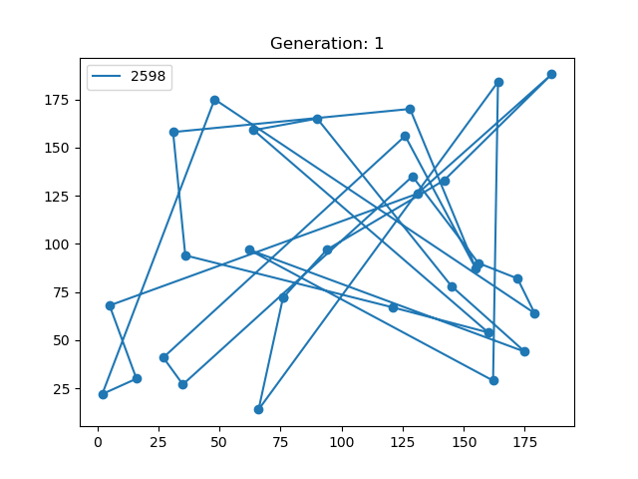
3.7 TSP and GA
TSP (Traveling Saleman Problem) is a rather troublesome NP difficulty problem
At 10 cities, the total number of combinations is 181440
→ 0.0000002 sec.
On 10TFlops PC
At 30 cities, the total number of combinations is 4.42 x 10³⁰
→ 250 billion years
On 10TFlops PC
TSP made GA famous.
Notes:
(Omitted)
(at 10…) However, (at 30)
However, GA get the answer a few second.
I know that “TSP made GA famous in the world”

Slide 12
3.8 How to use GA(or other AI technologies)
Be careful !
GA has no guarantee of finding an exact answer → only a rough optimal answer
Answer
Exact answer
(Perfect 100%)
Optimal answer
(99%, for example)
Time
1 sec./min./hour
Beyond the universe life time
Most AIs do not aim for the best answer
Quasi-optimal solution is good enough.
Notes:
(omitted)
In addition what I have to say loudly is (Omitted)
In general, we don’t have to get the perfect answer in our life. More that 90% is enough.

Slide 13
3.9 Application: Operation “Christmas date”
Make a Christmas date schedule in GA
Item | Contents
Purpose | Select four male friends and take them for a Christmas date.
Target | Date a different man each day for 4 days, December 23-26
Evaluation | Maximize the sum of score of the four male friends
Assume that you are a popular girl in a college seminar.
Notes:
I would like introduce an application using GA, whose title is Operation “Chirsmas date”

Slide 14
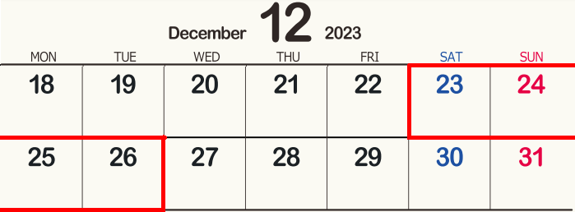

3.10 The Operation “Christmas date” planning
Illustrated by Ebata
Notes:
She is now thinking how to realize a good date during around Christmas event to get a good boyfriend.
She is going to date everyday from the December 23rd to 26th.

Slide 15
3.11 Conditions of this operation
Make a Christmas date schedule in GA
Item | Contents
Conditions | (1) She has nine male friends she can ask out on dates.
 | (2) She has assigned each man a rating function from 1 to 9 for (a) looks, (b) age, (c) income, and (d) potential. She don’t care of “love” at all
 | (3) Some males have days when they can't date. (Because of their own the Christmas strategy )
 | (4) The evaluation value of males who dates on December 24th or 25th doubles Because she think the days are important.
Notes:
This table shows her conditions for this Operation Christmas date
(Omitted)

Slide 16
3.12 Scoring of male friends
List of men (male Mr. A to Mr. I)
with their ratings (1 to 9)
Name | Mr.A | Mr.B | Mr.C | Mr.D | Mr.E | Mr.F | Mr.G | Mr.H | Mr.I
Looks | 3 | 8 | 8 | 4 | 3 | 6 | 9 | 8 | 5
(b) Age | 4 | 9 | 6 | 2 | 1 | 8 | 4 | 4 | 9
(c) Income | 4 | 3 | 6 | 9 | 5 | 0 | 5 | 6 | 0
(d) Potential | 7 | 1 | 3 | 1 | 6 | 7 | 3 | 2 | 7
(e) Bad day | 23rd |  |  | 24th |  |  | 23rd
She tries to pick four males and
assign them December 23rd -26th
Notes:
This table shows her scored make friends.
For example, she think, about Mr.A his looks is not so good, his age and income are also not good, however, his potential is relatively high.
To tell you the truth, I don’t know what she is thinking, however this is from her subjective viewpoint, anyway.
In addition, Mr.A has already assigned the 23rd day, maybe he also have some tragedy for another girl date planning.

Slide 17
3.13 Make genes
Genes in ordered representation.
23rd | 24th | 25th | 26th
A
B
C
D
E
F
G
H
I
Mr.E | Mr.B | Mr.A | Mr.H
1
2
3
4
5
6
7
8
9
5
1
2
3
4
×
5
5
6
7
8
2
1
×
×
2
2
3
5
4
5
6
7
1
×
×
×
1
2
1
2
5
3
4
5
6
5
← This is the GA gene
5 | 2 | 1 | 5
Notes:
This figure introduce the most important and effective method to make gene for GA.
First, make a series of Alphabet from Mr.A to Mr.I and the next link the number from 1 to 9 under the series of Alphabet.
In this case, Mr.E, Mr.B, Mr.A. Mr.H are assigned with the each day of 23rd ,24th, 25th and 26th.
First, Mr.E can get the number 5, and this 5 is deleted, and the sequence of number is reset like that
Next, Mr.B can get the number 2 and this 2 is deleted, and the the sequence of number is reset like that.
Next, Mr.A can get the number 1 and this 1 is deleted and the sequence of number is reset like this.
Finally, Mr.H can get the number 5 and this 5 is deleted.
I think why Ebata is doing, but after that I will explain the purpose.

Slide 18
3.14 Make genes
genes in ordered representation.
23rd | 24th | 25th | 26th
E | B | A | H
5 | 2 | 1 | 5
A | B | C | D
1 | 1 | 1 | 1
I | G | F | D
9 | 7 | 6 | 4
C | E | G | I
3 | 4 | 5 | 6
H | F | B | C
8 | 6 | 2 | 2
・
・
・
・
H | F | D | A
8 | 6 | 4 | 1
Anyway, make lots of genes at random
Notes:
This figure shows the result of gene’s sequence from the males sequence.
Anyway, the number of male’s sequence is 9! / 5! = 3023.
To tell you the truth, this number is too small to use the GA.
In real case, the person’s sequence is one month, 30days. In that case, the number of combination is 2.65 x 10^32

Slide 19
3.15 Crossover genes
Replace a part of genes
23rd | 24th | 25th | 26th
E | B | A | H
5 | 2 | 1 | 5
A | B | C | D
1 | 1 | 1 | 1
A | B | C | H
1 | 1 | 1 | 5
E | B | A | C
5 | 2 | 1 | 1
Notes:
Let’s try the crossover
In this case, crossover’s point is just half of gene, and please pay attention!
After the cross over, when the number of gene is decoded, we don’t have to worry about the the same person happen in the male’s sequence.
This is the ordered representation magic.
The most important thing to use the ordered representation, No killed gene happens.
This means, each gene is not killed by the environment , just killed or selected by GA algorism.

Slide 20
3.16 Mutation genes
Intentionally damage a part of a gene
23rd | 24th | 25th | 26th
E | B | A | H
5 | 2 | 1 | 5
E | B | C | H
5 | 2 | 2 | 5
Destroy deliberately the gene working well
Notes:
This figure shows how to realize the mutation.
If you (or computer) input random number (from 1-9) , the gene is not killed by the the ordered representation

Slide 21
3.17 Evaluation of male friends
Numerical evaluation of "good" and "bad"
23rd | 24th | 25th | 26th
E | B | A | H
Name | Mr.A | Mr.B | Mr.C | Mr.D | Mr.E | Mr.F | Mr.G | Mr.H | Mr.I | Sum
Looks | 3 | 8 | 8 | 4 | 3 | 6 | 9 | 8 | 5 | 33
(b)Age | 4 | 9 | 6 | 2 | 1 | 8 | 4 | 4 | 9 | 31
(c)Income | 4 | 3 | 6 | 9 | 5 | 0 | 5 | 6 | 0 | 33
(d)Potential | 7 | 1 | 3 | 1 | 6 | 7 | 3 | 2 | 7 | 24
(e)Bad day | 23rd |  |  | 24th |  |  | 23rd
×2
(25th)
×2
(24th)
×1
×1
Total 88
Notes:
Next I would like to explain how to evaluate each gene.
This schedule shows, she date Mr.E, Mr.B. Mr.A and Mr.H from the date of 23rd.
About Mr.A, the evaluation is 3+4+4+7 and multiplay the number by 2
About Mr.B, the evaluation is 8+9+3+1 and multiplay the number by 2
About Mr.E the evaluation is 3+1+5+6
About Mr.H the evaluation is 8+4+6+2
So this gene from the male sequence is total 88

Slide 22

3.18 Evaluation of male friends
Illustrated by Ebata
Notes:
You or your computer try to find the best evaluation using with GA.
In fact, this is very useful for me, so I will GA for the dynamic on demand bus routing problem, and privately I used it to find the purchase ratio of a stock, for example.

Slide 23
3.19 Attention about GA
The most important thing is to design genes not killed by the environment.
Environment
○ ○ ○ ○
○ ○ ○ ○
○ ○ ○ ○
○ ○ ○ ○
○ ○ ○ ○
○ ○ ○ ○
○ ○ ○ ○
○ ○ ○ ○
○ ○ ○ ○
○ ○ ○ ○
“Elites" and “Selection" are meaningless,
if the population would die out.
Notes:
I say again.
(omitted)

Slide 24
Exercise
Using the two genes,
Operation the following
(Attention) If the bad day hits, Score of from (a) to (d) should be ZERO(0)
23rd | 24th | 25th | 26th
(Step 1) Make two ordered representation by the “3.5” and “3.6”
A | B | C | D
(Step 2) Crossover two genes at the center by the “3.8”
E | F | G | H
(Step 3) Remake two genes by the “3.9”
(Step 4) Evaluate total cost (just these two genes) by the “3.10”
Please write down the process “Simply”.

Slide 25
4. Reinforcement Learning
“RL”
Notes:
Let’s go to the next topic. Reinforcement Learning, short for “RL”

Slide 26

4.1 What’s Reinforcement Learning
"Praise them when they do well
and scold them when they fail."
Action A
Action B
Action C
Good
Good
Good
Success!
Action A
Action B
Action C
Action X
Action Y
Action Z
Bad
Bad
Bad
Fail!
Action A
Action B
Action C
Really, this is all.
Notes:
What’s Reinforcement Learning.
The mechanism is very simple.
(Omitte)
If RL could reach the purpose, good values, or winner of games, RL just praises the procedure from the opposite direction, from the goal to the start.
If RL can fail to search the purpose, good values, or winner of games, RL just scold the procedure from the opposite direction, from the goal to the start.
Believe or not, THIS IS ALL of Reinforcement Learning.

Slide 27



Ebata’s trial for RL
The only thing I ever ordered to the Taxi.
“Pick up the customer and drop of at the dest”
Drop of at the destination
Pick up the customer
I didn’t give any order but just “shortest time”
Notes:
In this case, I give the taxi just one value “Short time is the best”, when the taxi can pick up a customer, and drop down the destination.
Taxi know
Where the customer is (which direction or how far)
Where the destination is (which direction or how far)
And the taxt’s action is going to just four up(north), down(south), right(east), left(west)

Slide 28
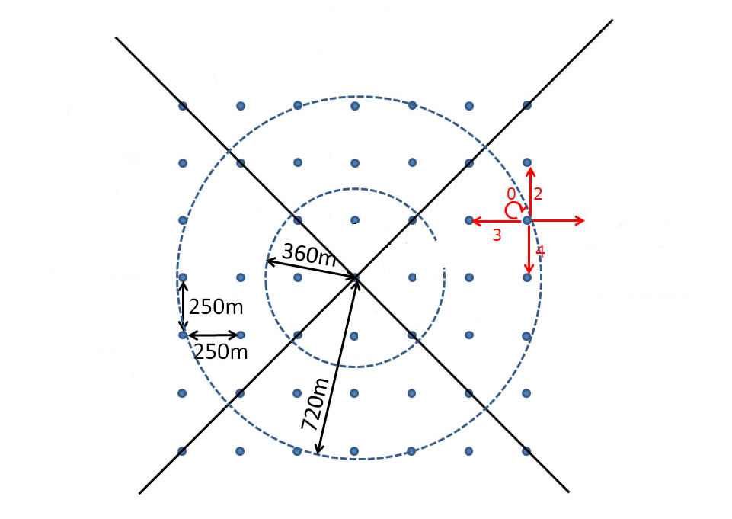



4.3 Ebata’s trial for RL(1)
Have the taxi understand the current status as follows
Area 1
The taxi can only know the following two information
(1) Location information of passengers waiting at the stop
(2) Destinations after picking up passengers
The taxi action is fairly easy,
only 4 states of action:
↑:0 ↓:1 →:2 ←: 3
Point1
Point2
Point3
Area 2
Area 0
Area 3
 | Where is the Passenger? |  |  |  | Where is the Station?
Area | 0 | 1 | 2 | 3 | 0 | 1 | 2 | 3
Point | 3 | 0 | 0 | 0 | 0 | 1 | 0 | 0
Notes:
In this case, I give the taxi just one value “Short time is the best”, when the taxi can pick up a customer, and drop down the destination.
Taxi know
Where the customer is (which direction or how far)
Where the destination is (which direction or how far)
And the taxt’s action is going to just four up(north), down(south), right(east), left(west)

Slide 29
4.4 Ebata’s trial for RL(2)
 | Where is the Passenger? |  |  |  | Where is the Station?
Area | 0 | 1 | 2 | 3 | 0 | 1 | 2 | 3
Point | 3 | 0 | 0 | 0 | 0 | 1 | 0 | 0
30000100 in quadrature → (conversion) → "49168" in decimal
Action
49168:0
When the Taxi choose “↑(0) then will be made.
Many pairs of “status:action” will be made
If a passenger is able to arrive at the station in a shorter time, the pair is placed higher on the list.
In this case, I have confirmed
thousands of pairs made.
Action
XXXX:Y
Action
XXXX:Y
Action
XXXX:Y
Action
XXXX:Y
Action
XXXX:Y
Action
XXXX:Y
Action
XXXX:Y
Action
XXXX:Y
Action
XXXX:Y
Action
XXXX:Y
Action
XXXX:Y
Action
XXXX:Y
Action
XXXX:Y
Action
XXXX:Y
Action
XXXX:Y
Action
XXXX:Y
Action
XXXX:Y
Action
XXXX:Y
Action
XXXX:Y
Action
XXXX:Y
Action
XXXX:Y
Action
XXXX:Y
Action
XXXX:Y
Action
XXXX:Y
Action
XXXX:Y
Action
XXXX:Y
Action
XXXX:Y
Action
XXXX:Y
Action
XXXX:Y
Action
XXXX:Y
Action
XXXX:Y
Action
XXXX:Y
Action
XXXX:Y
Action
XXXX:Y
Action
XXXX:Y
Action
XXXX:Y

Slide 30
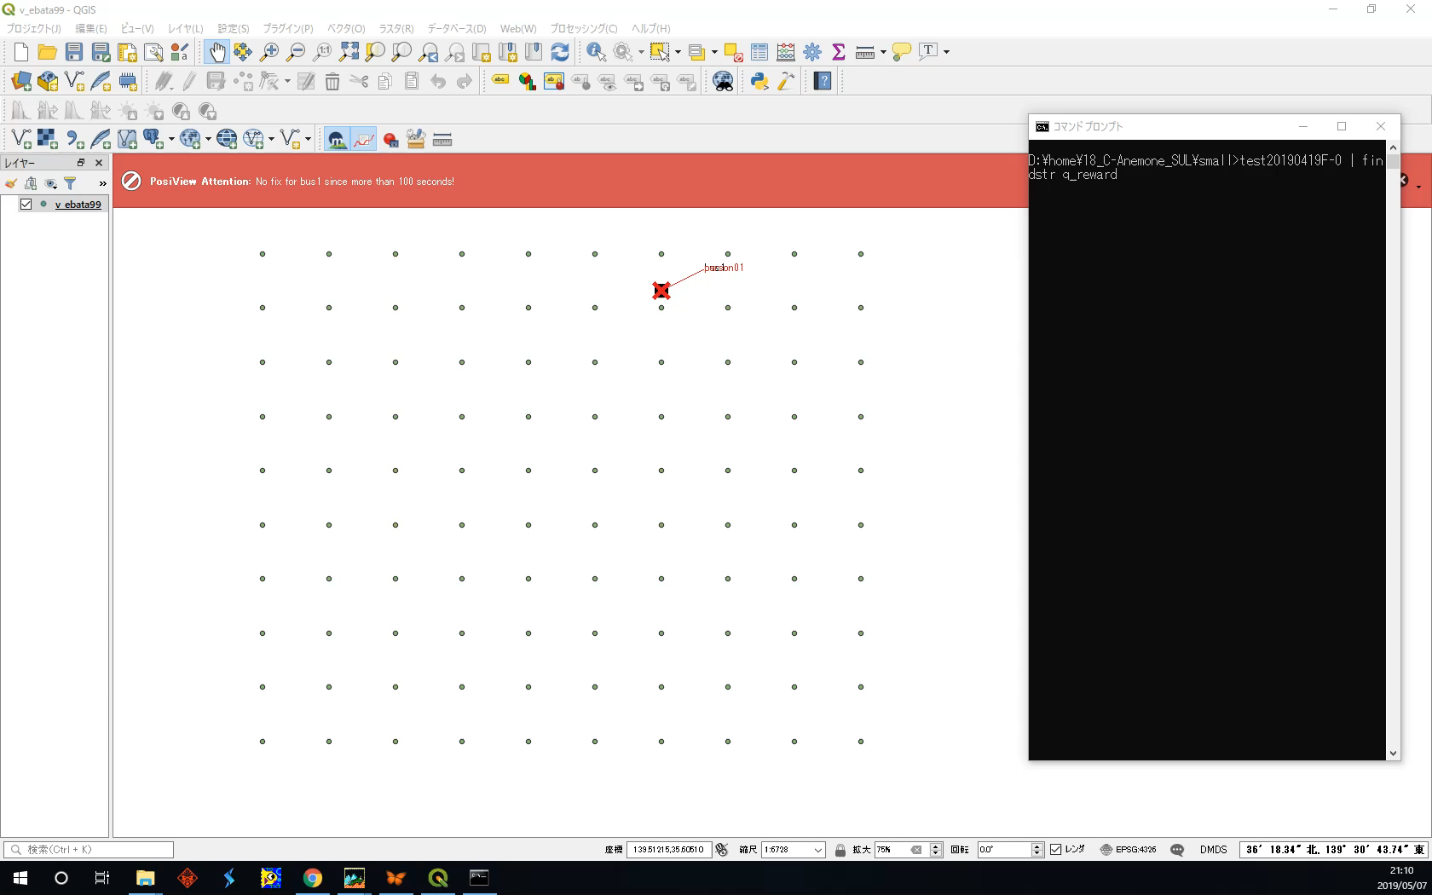
4.5 Ebata’s trial for RL(3)
Notes:
This is movie I made the program to know the RL mechanism.
I remember that this taxi finally get original rules by oneself.
However, the need of time was very long , more that several minutes were needed.
Do you think why I don’t use Fuzzy or GA?
The answer is an environment changing. So RL the best much for games.

Slide 31
4.5 Why “RL”
“RL” is so easy
Temp. Humi. | Low | Middle | High
Low | Heat(+1)
Middle |  |  | Cool(-1)
High |  | Stop(0) | Cool(-1)
Low
Middle
High
Fuzzy
10 20 30 deg.
(a) Temperature
Low
Middle
High
W[0][A]
W[0][B]
X
0
W[A][Z]
A
Neuro
Y
1
B
Z
Z
-1.0
2
-1.0
C
W[B][Z]
W[C][Z]
Crossover
1 2 3 4
1 2 3 4
2 1 4 3
GA
Mutation
Crossover
Mutation
1 2 4 3
1 2 4 3
2 1 3 4
In principle, leave “RL” alone
“RL” get their rules automatically
RL
Notes:
Why “RL” is so popular
The reason is just “easy” to make the codes
Fuzzy needs fuzzy table and membership function
Neuro prepares complex neural network model.
GA should have to deign a good gene , not to be killed by environment
On the other hand, “RL” don’t need the modeling

Slide 32

4.6 Magic formula of RL (Q-learning)
RL is based on the following formula ONLY
State S at time t
State S at time t+1
Action a
Action p
α is the learning rate,
γ is the discount factor. It quantifies how much importance we give for future rewards.
Max[Q(s’, A)] gives a maximum value of Q for all possible actions in the next state.
In order to realize the above formula,
I only used 4 lines(in the program)
Notes:
Q-learning is the most famous RL method.
Q-Learning users just this simple formula.
In this formula,
α is the learning rate,
γ is the discount factor. It quantifies how much importance we give for future rewards.
Max[Q(s’, A)] gives a maximum value of Q for all possible actions in the next state.
In fact, in order to realize the above formula, just four lines in the program are needed.
(Of course, I had to prepare for large memory to store the pair of States and Action)て

Slide 33

4.7 Reinforcement learning mechanism (1)
One day, many tubs were sold.
Why ?
A:Action
S:State
Tub
Notes:
This is a sample, “One day, many tubs were sold in a shop” and “Why”

Slide 34






4.8 Reinforcement learning mechanism (2)
In conclusion, this is the answer
A:Action
With the growing number of blind people, the action" to mass produce the shamisen.
Dust
blind person
Shamisen
Cat
Wind
Tub
Mouse
S:State
Cats are being captured as material for the shamisen, and the number of cats is decreasing,
And rats bite tubs
Notes:
First I say the answer
Famous Japanese proverb, "If the wind blows, the bucket shop will prosper.“
The winds makes dust
Dust makes blind persons
blind persons buy shamisen (Japanese traditional guitar). In Old Japan, blind person played and sing with the samisen
With the growing number of blind people, the action" to mass produce the shamisen.
Cats are being captured as material for the shamisen, and the number of cats is decreasing,
And rats bite tubs
So many Tubs were sold

Slide 35

4.9 Reinforcement learning mechanism (1)
Let’s explain “RL” from view of “bribe”
Illustrated by Ebata
Notes:
I will try to explain this “RL” from the viewpoint “Money”, “Power” and “Bribe”
“Bribe” means “black money”, “unfair money”, or “illegal money”

Slide 36




4.10 Reinforcement learning mechanism (2)
Give much money to the status that contributed to the sales of the tub.
Tub

Slide 37
4.11 Reinforcement learning mechanism (3)
One state will accommodate the next state in order to get money
Tub
Reinforcement Learning is so called
"Bribe network"

Slide 38

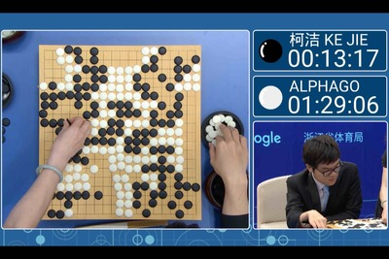
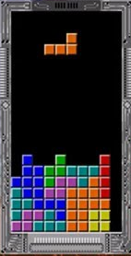
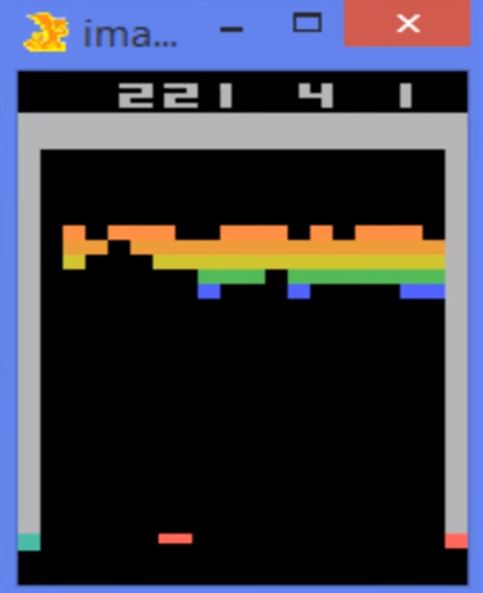
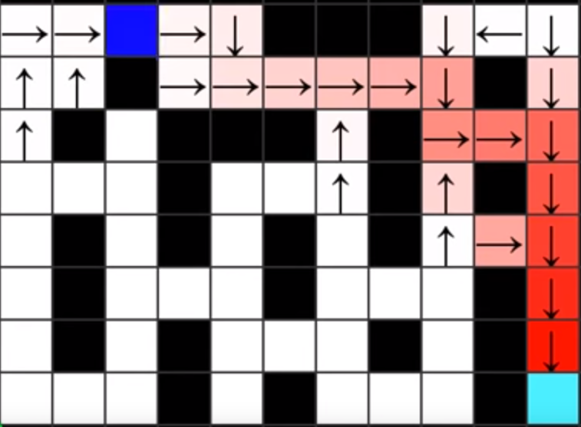
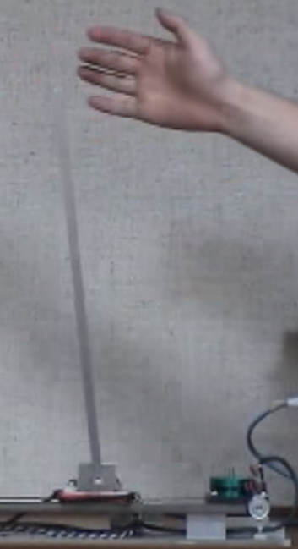
4.12 Examples of reinforcement learning
Computers have not been able to beat humans for a long time.
Shogi
Igo
Game
Search problem
Auto Tuning
Notes:
For Shogi igo chess and other games, the champion is computer with RL now.

Slide 39
4.13 Magic of RL(1)
As for Shogi and Go, I believed that computers could never beat humans.
Target | Numbers of calculation
Chess steps | 10 to the 120th power = 10¹²⁰
Shogi steps | 10 to the 220th power = 10²²⁰
Igo steps | 10 to the 360th power = 10³⁶⁰ (“3061th = 10³⁶⁰¹”, someone said)
Because the solution space is too large.

Slide 40
4.14 Magic of RL(2)
In the end, computers beat humans by "RL”
Points | Viewpoints
(1) RL can implement games on computers | (A) Rules are clear, (B)Solution space is fixed (in the game board), (C) Win/Loss criteria are clear, and (D) Game time is finite.
(2) RL can be learned by only computers | Games can be played between computers without human
…Or I gues that he space for win might be small

Slide 41
Conclusion

Slide 42
What’s AI ?

Slide 43
AI is not technology
AI is just a “concept”
■Probability theory
■Optimization Algorithm
■Statistics
■Image recognition
■Voice recognition
■Constraint theory
■Natural language processing
■Search
AI
(Artificial Intelligent)
■Game theory
■ OR
■Neural Networks
■Machine learning
■Automatic Translation
■Human interface
■Case-based reasoning
■Multi-agent simulation
■Expert
■Bayesian network
■Data mining
■Genetic Algorithm (GA)
■Fuzzy reasoning
consisting of many software tech.

